Slide 1
The Ten Common Mistakes for Business Failure
By Dr. John Persico Jr.

Slide 2
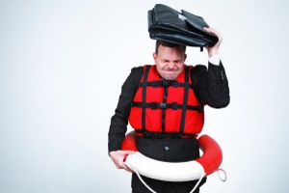
1. Stop Taking Risks
There are three types of risk
  Risk aversive

Slide 3
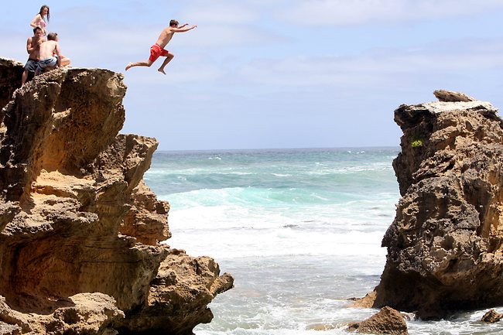
1. Stop Taking Risks
  Risk foolish

Slide 4

1. Stop Taking Risks
  Risk strategic

Slide 5
2. Be Inflexible
Inflexibility meaning

Slide 6
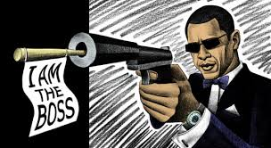
2. Be Inflexible
Read my lips
My way or the highway
This is the way that we always have done it

Slide 7
2. Be Inflexible
Can you give me some examples of where you have seen inflexibility hurt your business or a business effort?

Slide 8
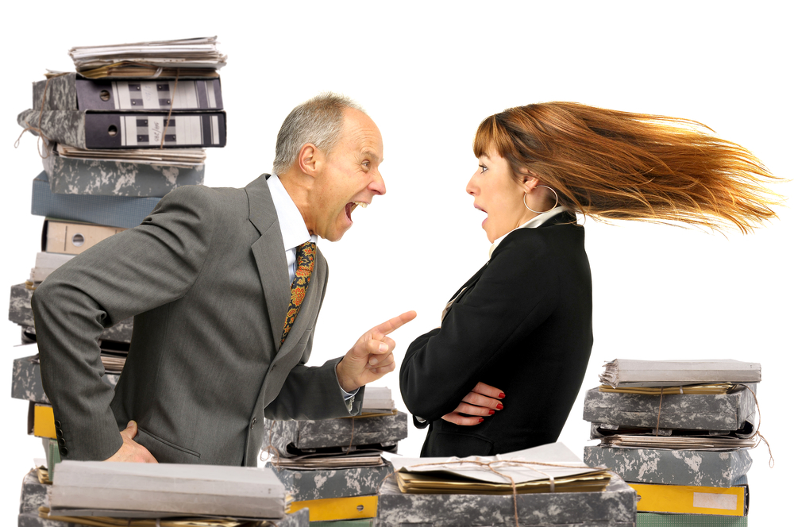
3. Isolate Yourself
Establish barriers to protect yourself
  Be gruff
  Be bluff
  Be unapproachable

Slide 9
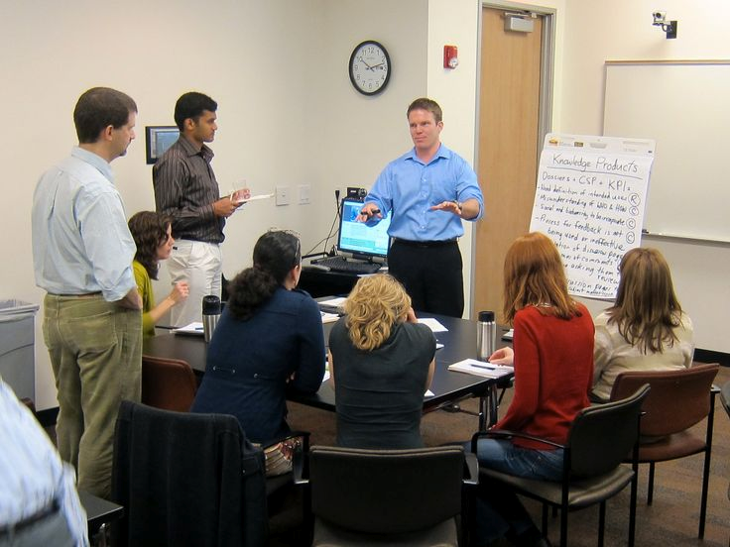
3. Isolate Yourself
Keep away from the employees and work

Slide 10
3. Isolate Yourself
Assume that you are the success
What does this mean?

Slide 11
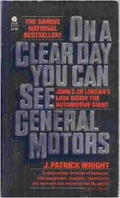
4. Assume Infallibility
Ignore problems

Slide 12
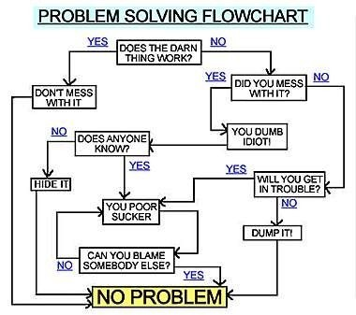
4. Assume Infallibility
Cover up mistakes

Slide 13
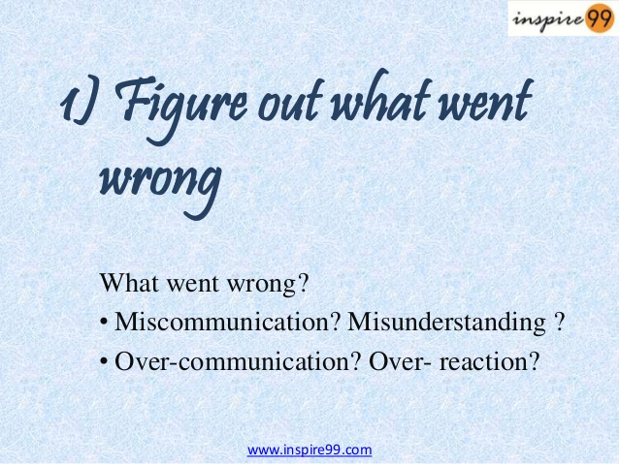
4. Assume Infallibility
Never ever do post-mortems
What is a business post-mortem? Why is it important? How do you do them in your organization?

Slide 14

5. Play the Game Close to the Foul Line
Business Ethics
Lets talk about Enron.
How many of your have read the book the “Smartest Guys in the Room?”

Slide 15
5. Play the Game Close to the Foul Line
Business Fairness
What does it take to make it right?
Famous BAD Customer Service
And Here Are the 10 Worst…
1. AOL - Playing Dirty, Tricking Customers?
2. BEST BUY - Worst customer service?
3. LASTMINUTE.COM - Customer who?
4. HOME DEPOT - Who cares about your home? Not us!
5. AT&T - The Next Dinosaur?
6. SBC - $200 to cancel the service!!!
7. DAY'S INN- We're racists AND We break promises
8. ALBERTSON'S - No value for customer privacy
9. MCIMETRO ACCESS (Formerly known as MCI Communications) -
10. CIRCUIT CITY - We have your money - now get lost!

Slide 16
5. Play the Game Close to the Foul Line
Business Transparency
Corporate transparency describes the extent to which a corporation's actions are observable by outsiders. This is a consequence of regulation, local norms, and the set of information, privacy, and business policies concerning corporate decisionmaking and operations openness to employees, stakeholders, shareholders and the general public. From the perspective of outsiders, transparency can be defined simply as the perceived quality of intentionally shared information from the corporation.

Slide 17
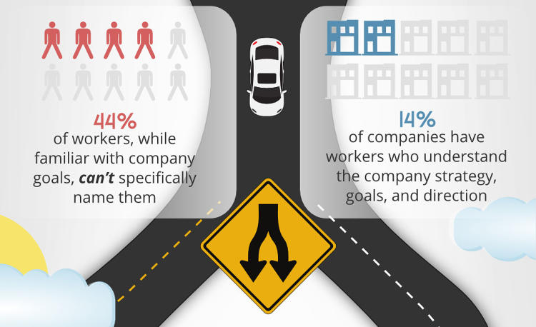
5. Play the Game Close to the Foul Line
Business Transparency – 3 Dimensions
Information Disclosure
Clarity
Accuracy
Can anyone give me some examples?

Slide 18
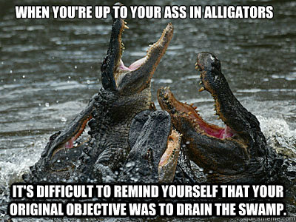
6. Don’t Take Time to Think
Stay busy fighting fires
  “Always time to do it over, but never time to do it right.
  “I’m really really busy.”
  “Gotta run, got things to do.”

Slide 19
6. Don’t Take Time to Think
Worry about today and not tomorrow!
“Failure of management to plan for the future and to foresee problems has brought about waste of manpower, of materials, and of machine-time, all of which raise the manufacturer’s cost and price that the purchaser must pay. The consumer is not always willing to subsidize this waste. The inevitable result is loss of market. Loss of market begets unemployment.” --- W. Edwards Deming

Slide 20
6. Don’t Take Time to Think
Ignore cause and effect
“If you can't describe what you are doing as a process, you don't know what you're doing.” ― W. Edwards Deming

Slide 21
7. Put All Your Faith in Experts
Story of the financial experts and the 2007 financial collapse.
Who Predicted the Financial Crisis?
The results from the first set of questions eliminated most of the world's economists, including Nobel Prize winners, celebrated economists, financial wizards, economic policy makers, and investment advisors. This does not take away from their intelligence, it simply shows they were wrong and that their decision models and policies must be corrected.

Slide 22
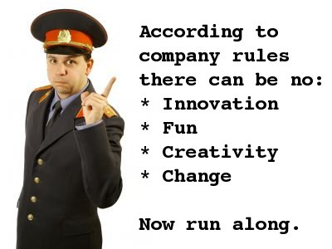
8. Love Your Bureaucracy
Focus on rules and policies and procedures
How much red tape do you have to deal with in your organization?

Slide 23
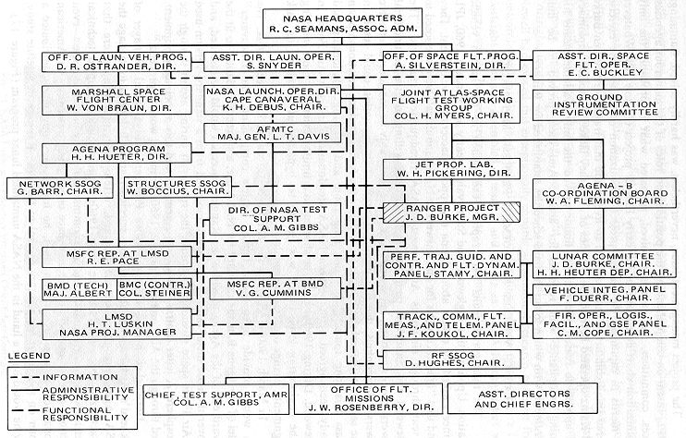
8. Love Your Bureaucracy
Create hierarchies

Slide 24
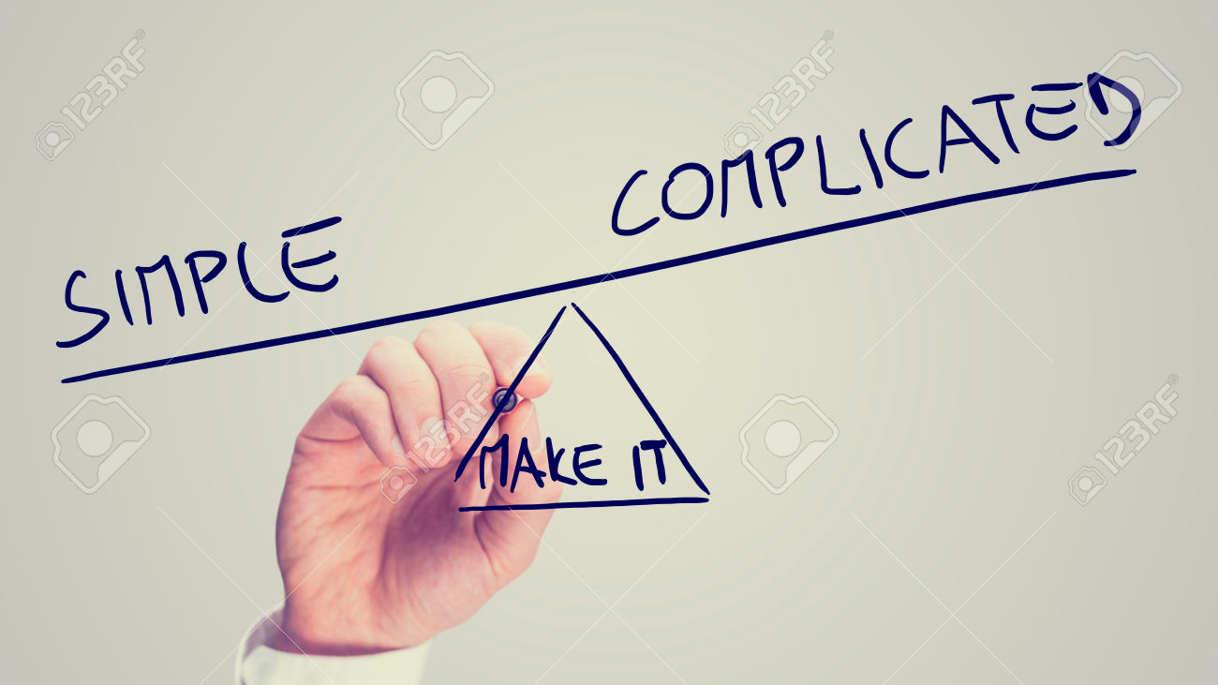
8. Love Your Bureaucracy
Create complexity

Slide 25
9. Send Mixed Messages
Assume that your meaning is clear
Soldiers Video

Slide 26
9. Send Mixed Messages
Rely on Electronic Communications
If Harry Potter Characters Texted

Slide 27
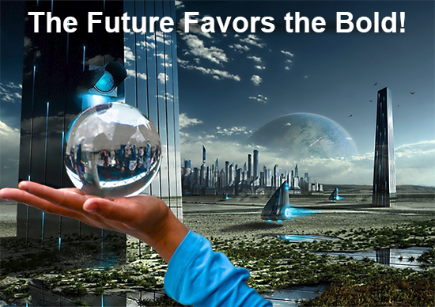
10. Be Afraid of the Future
Live in the past
Be a pessimist
Think short-term
For the past 33 years, I have looked in the mirror every morning and asked myself: 'If today were the last day of my life, would I want to do what I am about to do today?' And whenever the answer has been 'No' for too many days in a row, I know I need to change something. ---- Steve Jobs

Slide 28
IF
P- You want more profits
E- You want more efficiency in your operations
R- You want more results
S- You want a better long-term strategy
I- You want more innovation
C- You want more satisfied customers
O- You want more opportunities for your organization
Then call John Persico and Associates today to discuss how we can help your organization
612-310-3803

Slide 29
References and Sources
The key concepts in this presentation are based on the ideas of Donald R. Keough. “The Ten Commandments for Business Failure,” Portfolio/Penguin Publishing, 2008

